Slide 1
A Quantum Engineer’s Guide to Superconducting Qubits
DEPARTMENT OF MATHEMATICAL SCIENCES
Jack Mandell
11/21/24

Slide 2
Learning Goals of the Presentation
High-level understanding of
engineering superconducting qubit
types of noise and modeling noise
implementation of single-qubit operations
Connect the math to the engineering

Slide 3
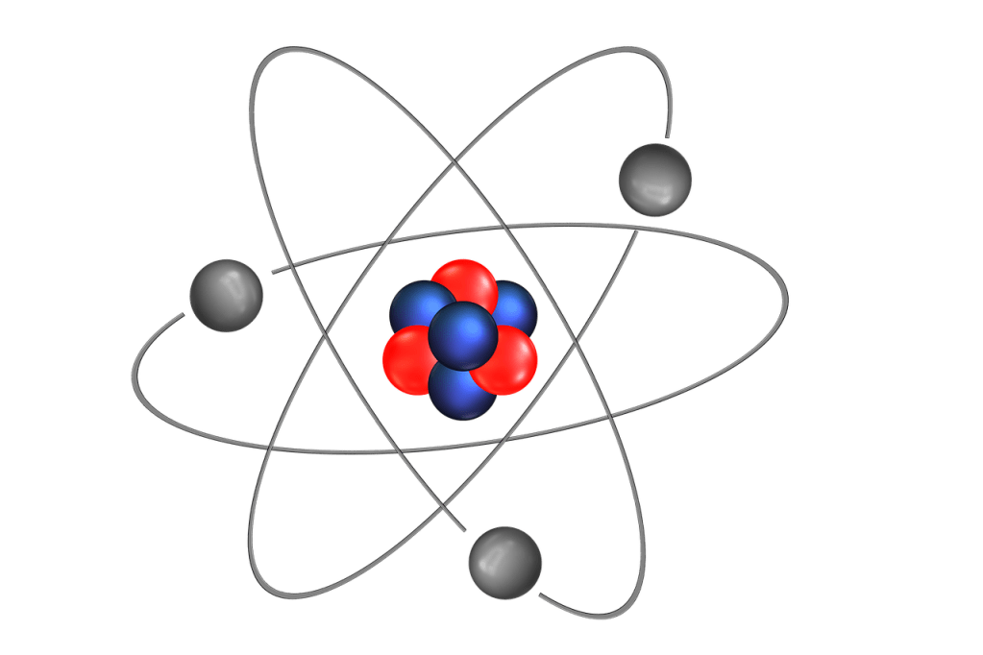
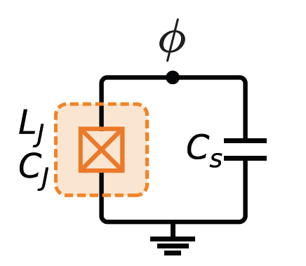
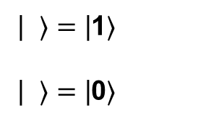
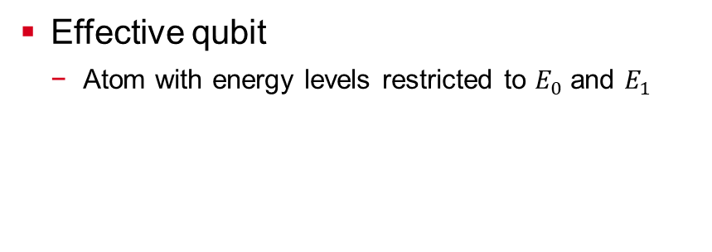
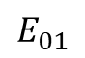
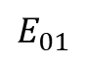
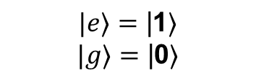
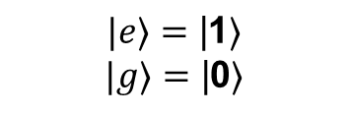
How Do You Represent a Quantum Bit (Qubit)?
Nature’s qubit:
Single spin-1/2 particle
Man-made qubit (“artificial atoms”)
Built from superconducting circuits
Freedom in design
Ex: transmon qubit, flux qubit
Effective qubit
Atom with energy levels restricted to $E_{0}$ and $E_{1}$
| $⟩=\text{|}\text{1}⟩$
| $⟩=\text{|}\text{0}⟩$
energy
$$|e⟩=\text{|}\text{1}⟩$$
$$|g⟩=\text{|}\text{0}⟩$$
$$E_{01}$$
$$|e⟩=\text{|}\text{1}⟩$$
$$|g⟩=\text{|}\text{0}⟩$$
$$E_{01}$$

Slide 4
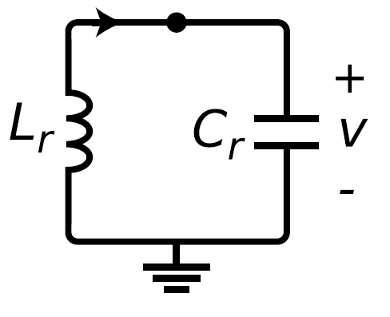
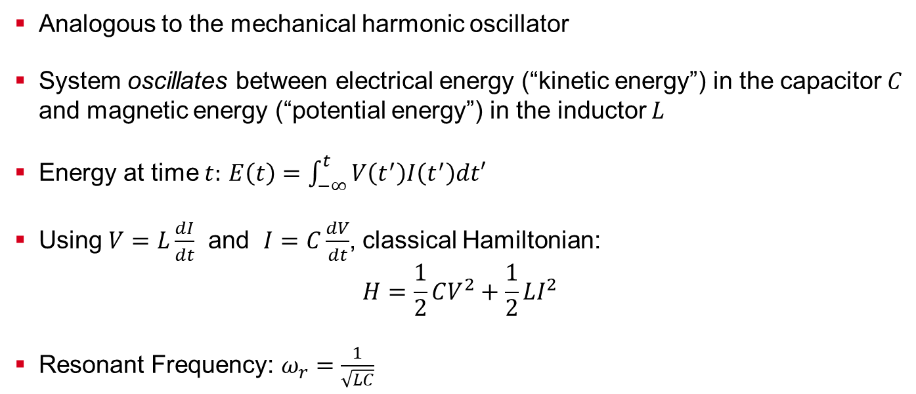
LC Resonator
Analogous to the mechanical harmonic oscillator
System oscillates between electrical energy (“kinetic energy”) in the capacitor $C$ and magnetic energy (“potential energy”) in the inductor $L$
Energy at time $t:$ $E\left(t\right)=\int_{−∞}^{t}{V\left(t^{′}\right)I\left(t^{′}\right)dt′}$
Using $V=L\frac{dI}{dt}$ and $I=C\frac{dV}{dt}$, classical Hamiltonian:
$$H=\frac{1}{2}CV^{2}+\frac{1}{2}LI^{2}$$
Resonant Frequency: $ω_{r}=\frac{1}{\sqrt{LC}}$

Slide 5
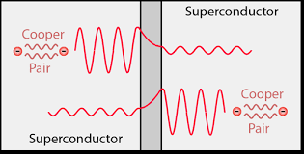
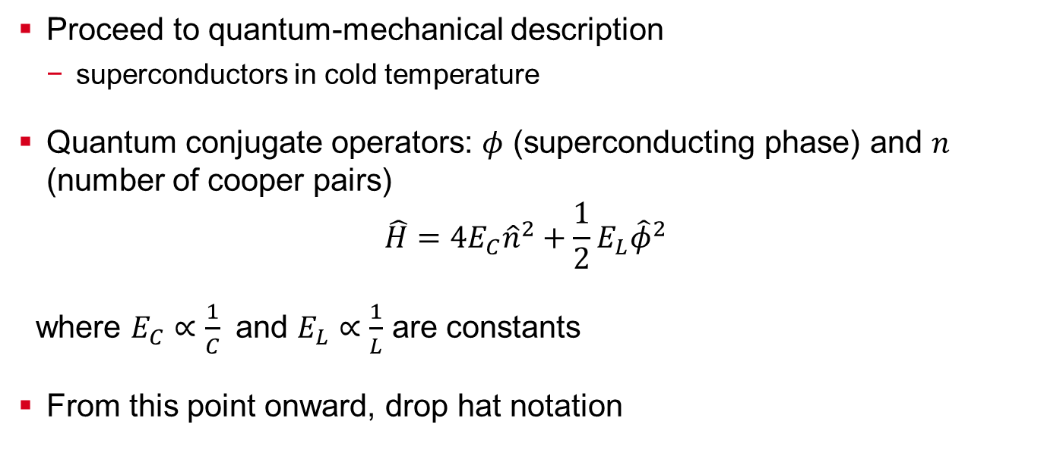
Quantum Harmonic Oscillator (QHO) – Hamiltonian Formulation
Proceed to quantum-mechanical description
superconductors in cold temperature
Quantum conjugate operators: $φ$ (superconducting phase) and $n$ (number of cooper pairs)
$$\hat{H}=4E_{C}{\hat{n}}^{2}+\frac{1}{2}E_{L}{\hat{φ}}^{2}$$
where $E_{C}∝\frac{1}{C}$ and $E_{L}∝\frac{1}{L}$ are constants
From this point onward, drop hat notation
Notes:
Nominally zero intrinsic dissipation and heat

Slide 6
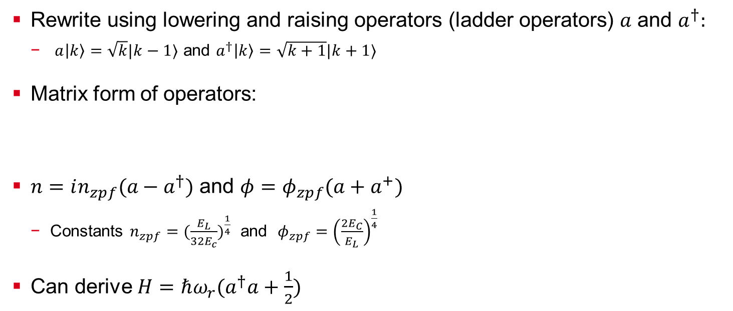
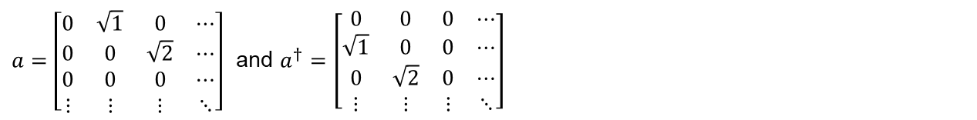
Quantum Harmonic Oscillator (QHO) – Hamiltonian Alternate Form
Rewrite using lowering and raising operators (ladder operators) $a$ and $a^{†}:$
$a\left|k\right\rangle =\sqrt{k}|k−1⟩$ and $a^{†}\left|k\right\rangle =\sqrt{k+1}|k+1⟩$
Matrix form of operators:
$n=in_{zpf}(a−a^{†})$ and $φ=φ_{zpf}(a+a^{+})$
Constants $n_{zpf}={(\frac{E_{L}}{32E_{c}})}^{\frac{1}{4}}$ and $φ_{zpf}={\left(\frac{2E_{C}}{E_{L}}\right)}^{\frac{1}{4}}$
Can derive $H=ℏω_{r}(a^{†}a+\frac{1}{2})$
$a=\left[\begin{matrix}0 & \sqrt{1} & 0 & ⋯ \\ 0 & 0 & \sqrt{2} & ⋯ \\ 0 & 0 & 0 & ⋯ \\ ⋮ & ⋮ & ⋮ & ⋱\end{matrix}\right]$ and $a^{†}=\left[\begin{matrix}0 & 0 & 0 & ⋯ \\ \sqrt{1} & 0 & 0 & ⋯ \\ 0 & \sqrt{2} & 0 & ⋯ \\ ⋮ & ⋮ & ⋮ & ⋱\end{matrix}\right]$

Slide 7
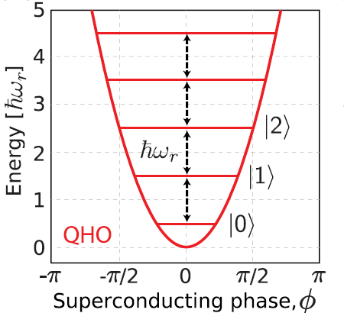
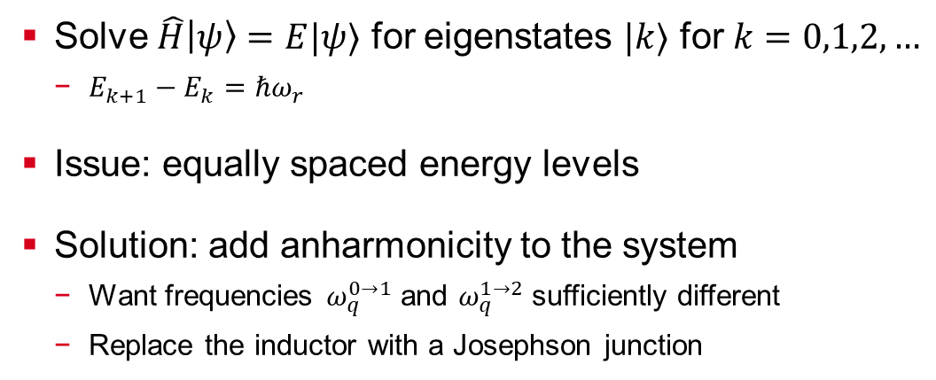
Quantum Harmonic Oscillator (QHO) – Issues for Qubit Building
Solve $\hat{H}\left|ψ\right\rangle =E|ψ⟩$ for eigenstates $|k⟩$ for $k=0,1,2,…$
$E_{k+1}−E_{k}=ℏω_{r}$
Issue: equally spaced energy levels
Solution: add anharmonicity to the system
Want frequencies $ω_{q}^{0→1}$ and $ω_{q}^{1→2}$ sufficiently different
Replace the inductor with a Josephson junction

Slide 8
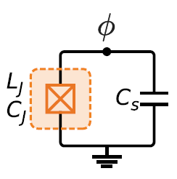
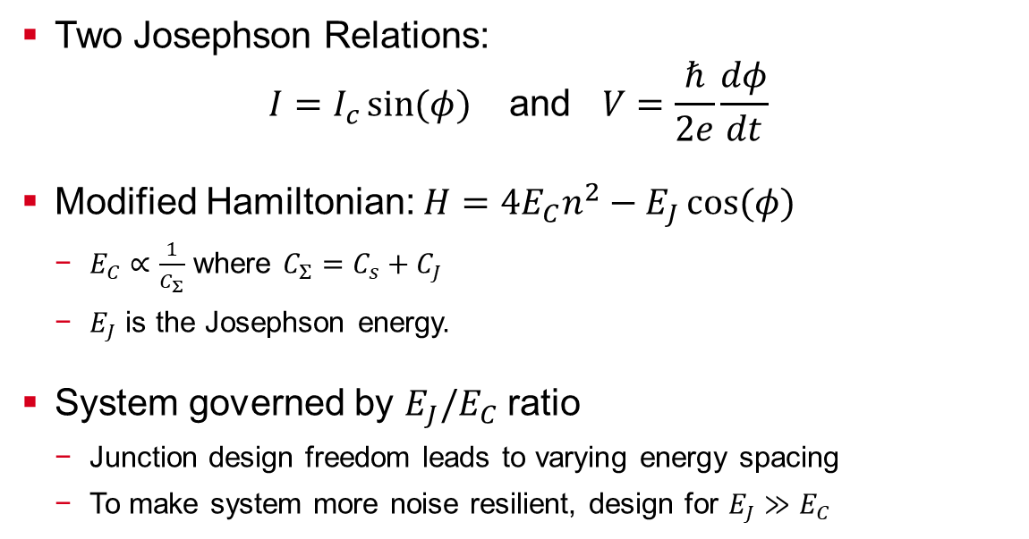
Analyzing the QHO with a Josephson Junction
Two Josephson Relations:
$$I=I_{c}\sin{(φ)} \text{and} V=\frac{ℏ}{2e}\frac{dφ}{dt}$$
Modified Hamiltonian: $H=4E_{C}n^{2}−E_{J}\cos{(φ)}$
$E_{C}∝\frac{1}{C_{Σ}}$ where ${C_{Σ}=C}_{s}+C_{J}$
$E_{J}$ is the Josephson energy.
System governed by $E_{J}/E_{C}$ ratio
Junction design freedom leads to varying energy spacing
To make system more noise resilient, design for $E_{J}≫E_{C}$

Slide 9
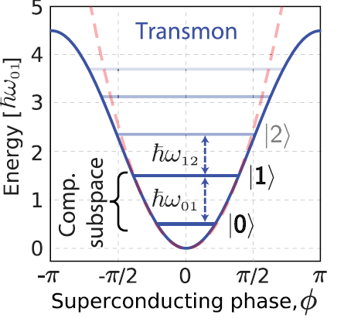
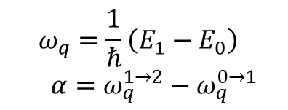
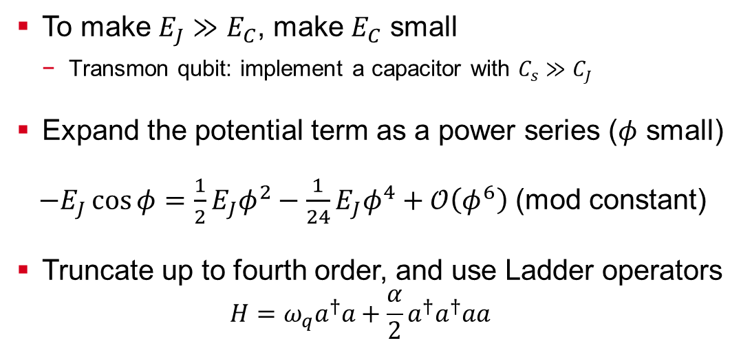
Transmon Qubit – Energy Spectra Analysis
To make $E_{J}≫E_{C}$, make $E_{C}$ small
Transmon qubit: implement a capacitor with $C_{s}≫C_{J}$
Expand the potential term as a power series ($φ$ small)
$−E_{J}\cos{φ}=\frac{1}{2}E_{J}φ^{2}−\frac{1}{24}E_{J}φ^{4}+𝒪\left(φ^{6}\right)$ (mod constant)
Truncate up to fourth order, and use Ladder operators
$$H=ω_{q}a^{†}a+\frac{α}{2}a^{†}a^{†}aa$$
$$ω_{q}=\frac{1}{ℏ}\left(E_{1}−E_{0}\right)$$
$$α=ω_{q}^{1→2}−ω_{q}^{0→1}$$
Notes:
Around 100-300MHz for alpha. Omegaq = 3 – 6GHz

Slide 10
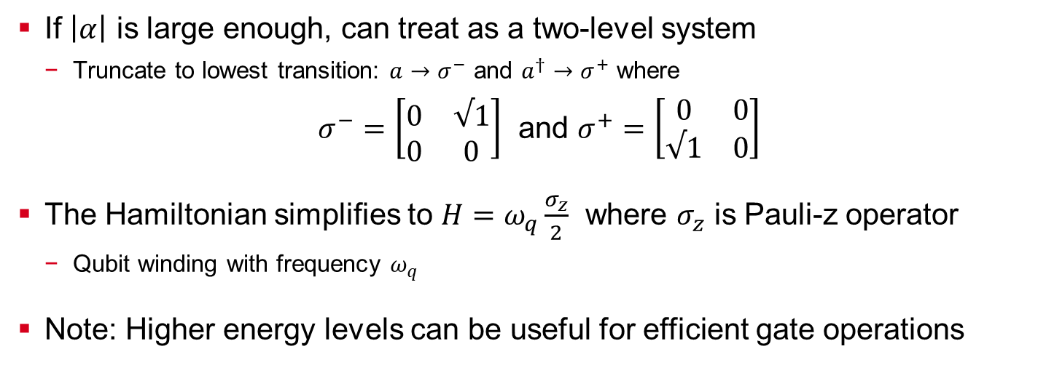
Transmon Qubit – Obtaining a two-level system
If $\left|α\right|$ is large enough, can treat as a two-level system
Truncate to lowest transition: $a→σ^{−}$ and $a^{†}→σ^{+}$ where
$σ^{−}=\left[\begin{matrix}0 & √1 \\ 0 & 0\end{matrix}\right]$ and $σ^{+}=\left[\begin{matrix}0 & 0 \\ √1 & 0\end{matrix}\right]$
The Hamiltonian simplifies to $H=ω_{q}\frac{σ_{z}}{2}$ where $σ_{z}$ is Pauli-z operator
Qubit winding with frequency $ω_{q}$
Note: Higher energy levels can be useful for efficient gate operations

Slide 11
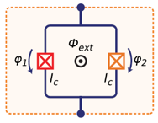
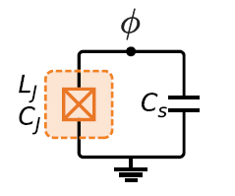
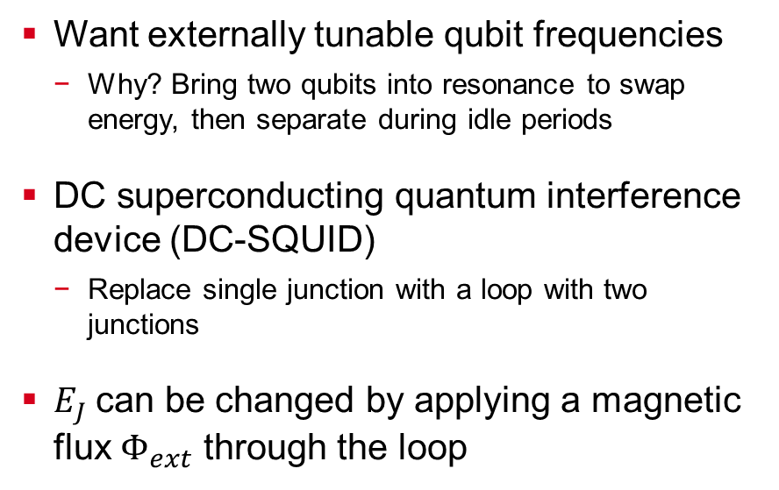
Split Transmon
Want externally tunable qubit frequencies
Why? Bring two qubits into resonance to swap energy, then separate during idle periods
DC superconducting quantum interference device (DC-SQUID)
Replace single junction with a loop with two junctions
$E_{J}$can be changed by applying a magnetic flux $Φ_{ext}$ through the loop

Slide 12
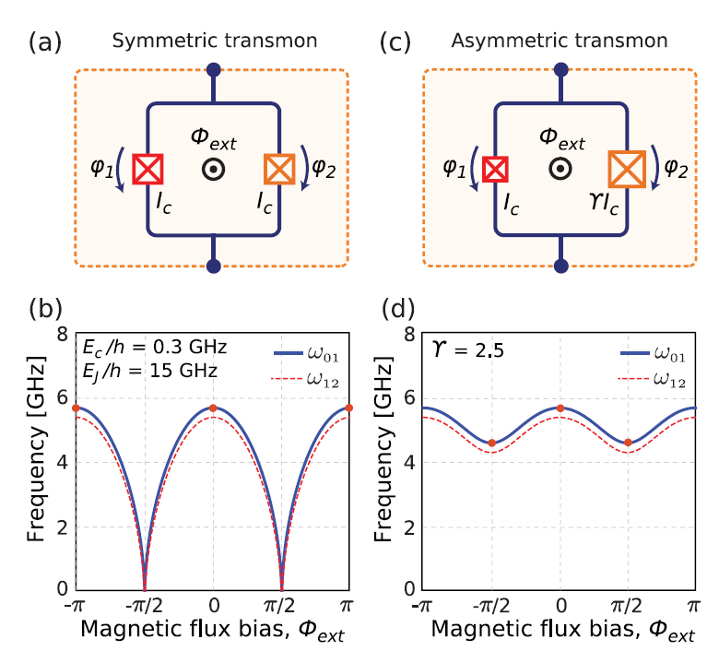
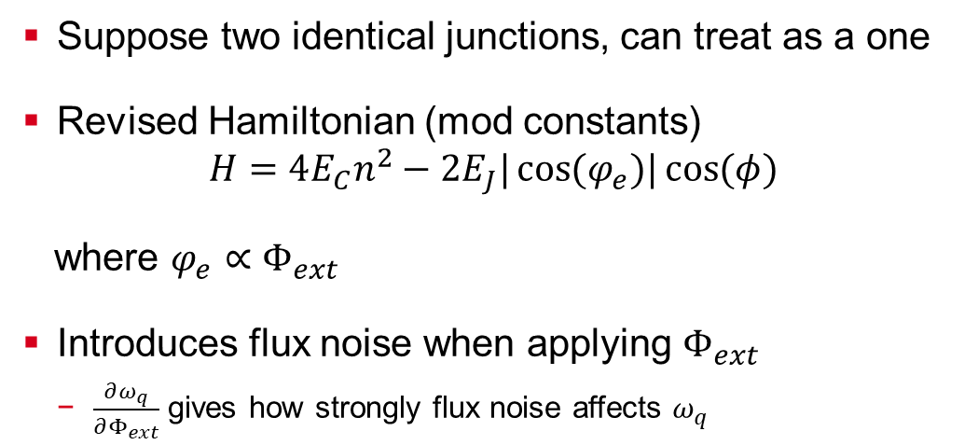
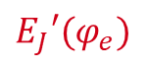
Symmetric Split Transmon
Suppose two identical junctions, can treat as a one
Revised Hamiltonian (mod constants)
$$H=4E_{C}n^{2}−2E_{J}|\cos{(φ_{e}})|\cos{(φ)}$$
where $φ_{e}∝Φ_{ext}$
Introduces flux noise when applying $Φ_{ext}$
$\frac{∂ω_{q}}{∂Φ_{ext}}$ gives how strongly flux noise affects $ω_{q}$
$$E_{J}′(φ_{e})$$
Notes:
The magnitude of the net, effective
Josephson energy E0J
has a period of U0 in applied flux and spans from
0 to its maximum value 2EJ. tuned periodically with Uext, see

Slide 13

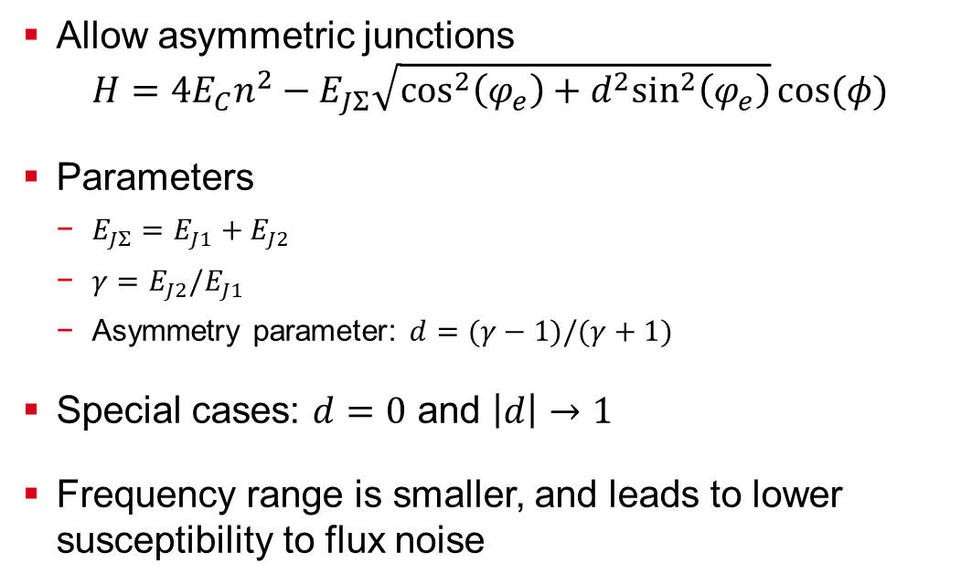
Asymmetric Split Transmon
Allow asymmetric junctions
$$H=4E_{C}n^{2}−E_{JΣ}\sqrt{\cos^{2}\left(φ_{e}\right)+d^{2}\sin^{2}\left(φ_{e}\right)}\cos{(φ)}$$
Parameters
$E_{JΣ}=E_{J1}+E_{J2}$
$γ=E_{J2}/E_{J1}$
Asymmetry parameter: $d=(γ−1)/(γ+1)$
Special cases: $d=0$ and $\left|d\right|→1$
Frequency range is smaller, and leads to lower susceptibility to flux noise
$$E_{J}′(φ_{e})$$
Notes:
The magnitude of the net, effective
Josephson energy E0J
has a period of U0 in applied flux and spans from
0 to its maximum value 2EJ. tuned periodically with Uext, see

Slide 14
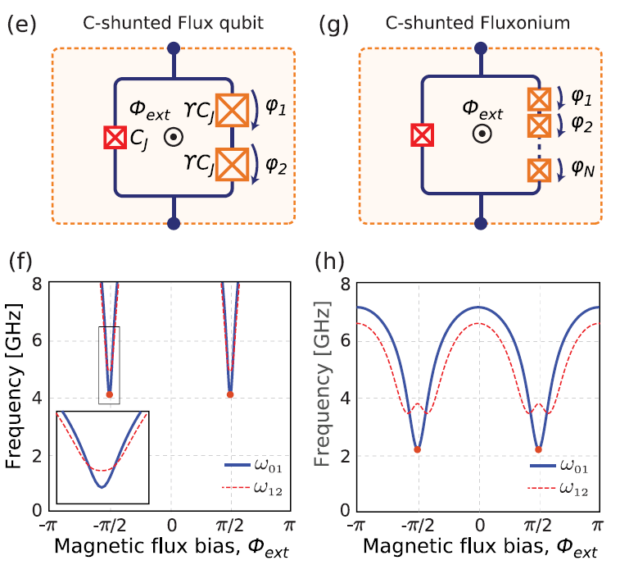
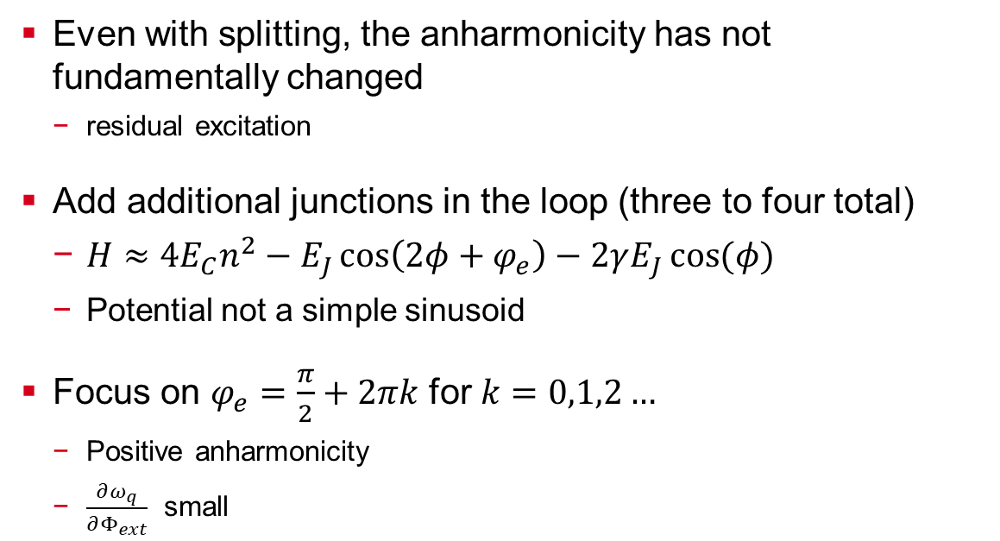
Flux Qubit
Even with splitting, the anharmonicity has not fundamentally changed
residual excitation
Add additional junctions in the loop (three to four total)
$H≈4E_{C}n^{2}−E_{J}\cos\left(2φ+φ_{e}\right)−2γE_{J}\cos{(φ)}$
Potential not a simple sinusoid
Focus on $φ_{e}=\frac{π}{2}+2πk$ for $k=0,1,2…$
Positive anharmonicity
$\frac{∂ω_{q}}{∂Φ_{ext}}$ small

Slide 15
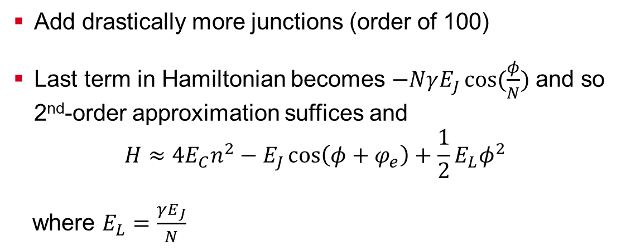
Fluxonium Qubit
Add drastically more junctions (order of 100)
Last term in Hamiltonian becomes $−NγE_{J}\cos{(\frac{φ}{N})}$ and so 2nd-order approximation suffices and
$$H≈4E_{C}n^{2}−E_{J}\cos\left(φ+φ_{e}\right)+\frac{1}{2}E_{L}φ^{2}$$
where $E_{L}=\frac{γE_{J}}{N}$

Slide 16
Types of Noise
Decoherence: deviation from predicted state qubit
Noise: physical processes that leads to decoherence of the qubit
Systematic noise
Lead to traceable or consistent errors in parameters
Ex: a pulse over-rotates a qubit by some fixed amount
Stochastic noise
Lead to random fluctuations of parameters
Ex: quality of electronics, cryogenics, engineering

Slide 17
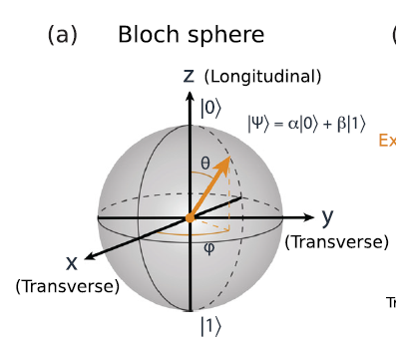
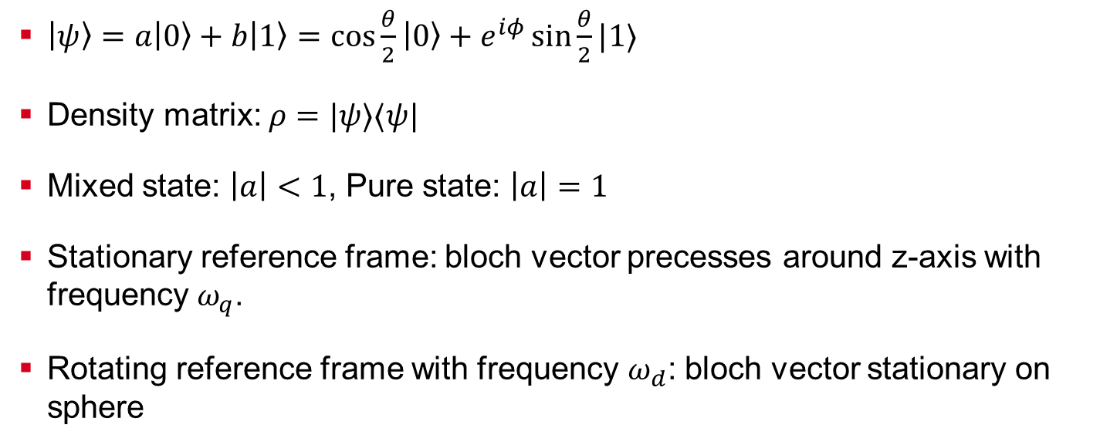

Bloch Sphere Model of Decohernece
$\left|ψ\right\rangle =a\left|0\right\rangle +b\left|1\right\rangle =\cos{\frac{θ}{2}}\left|0\right\rangle +e^{iφ}\sin{\frac{θ}{2}|1⟩}$
Density matrix: $ρ=|ψ⟩⟨ψ|$
Mixed state: $\left|a\right|<1$, Pure state: $\left|a\right|=1$
Stationary reference frame: bloch vector precesses around z-axis with frequency $ω_{q}$.
Rotating reference frame with frequency $ω_{d}$: bloch vector stationary on sphere
$$=\left[\begin{matrix}{\left|a\right|}^{2} & ab^{∗} \\ a^{∗}b & {\left|b\right|}^{2}\end{matrix}\right]$$

Slide 18
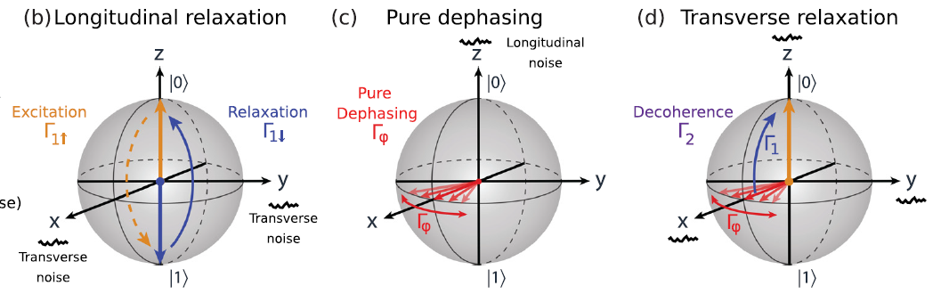
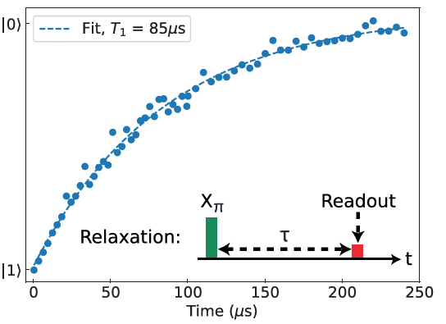
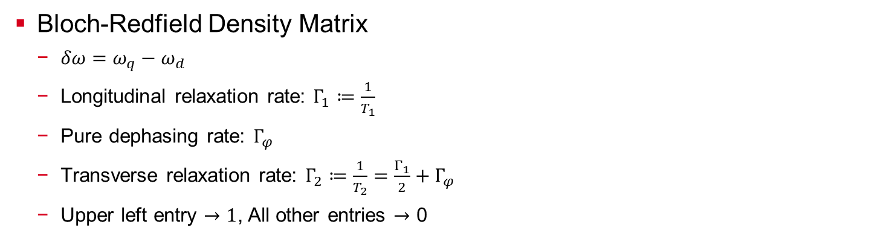
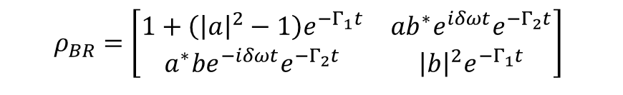
Bloch-Redfield Model of Decoherence
$$ρ_{BR}=\left[\begin{matrix}1+\left({\left|a\right|}^{2}−1\right)e^{−Γ_{1}t} & ab^{∗}e^{iδωt}e^{−Γ_{2}t} \\ a^{∗}be^{−iδωt}e^{−Γ_{2}t} & {\left|b\right|}^{2}e^{−Γ_{1}t}\end{matrix}\right]$$
Bloch-Redfield Density Matrix
$δω=ω_{q}−ω_{d}$
Longitudinal relaxation rate: $Γ_{1}≔\frac{1}{T_{1}}$
Pure dephasing rate: $Γ_{φ}$
Transverse relaxation rate: $Γ_{2}≔\frac{1}{T_{2}}=\frac{Γ_{1}}{2}+Γ_{φ}$
Upper left entry $→1$, All other entries $→$ 0
Notes:
explicit phase accrual,

Slide 19
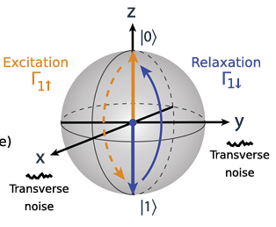
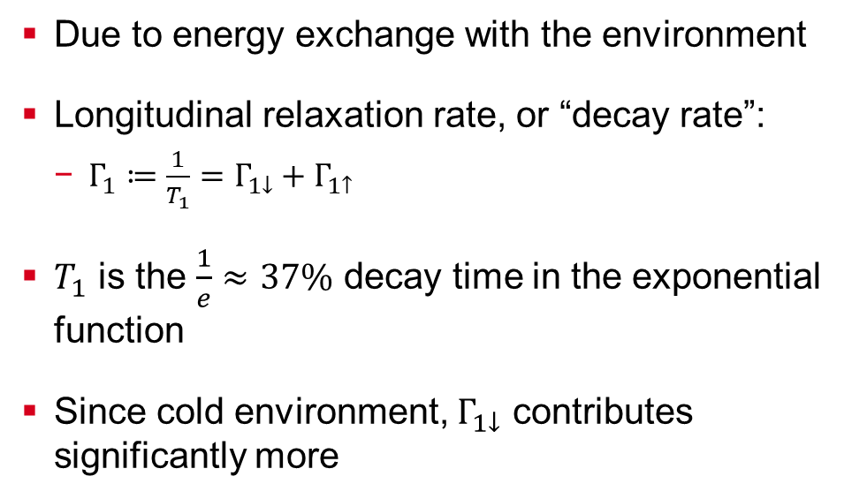
Longitudinal Relaxation
Due to energy exchange with the environment
Longitudinal relaxation rate, or “decay rate”:
$Γ_{1}≔\frac{1}{T_{1}}=Γ_{1↓}+Γ_{1↑}$
$T_{1}$ is the $\frac{1}{e}≈37\%$ decay time in the exponential function
Since cold environment, $Γ_{1↓}$ contributes significantly more

Slide 20
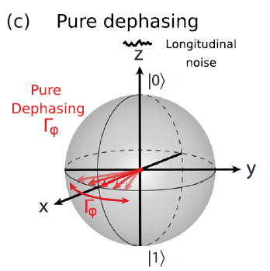
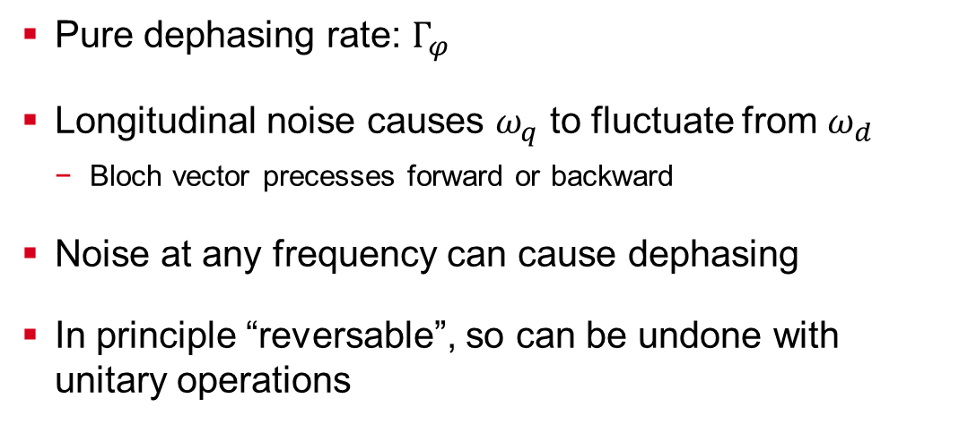
Pure Dephasing
Pure dephasing rate: $Γ_{φ}$
Longitudinal noise causes $ω_{q}$ to fluctuate from $ω_{d}$
Bloch vector precesses forward or backward
Noise at any frequency can cause dephasing
In principle “reversable”, so can be undone with unitary operations
Notes:
No energy exchange with environment. Can reverse because you know the direction it is rotating. With energy relxation, don’t know the orirign location

Slide 21
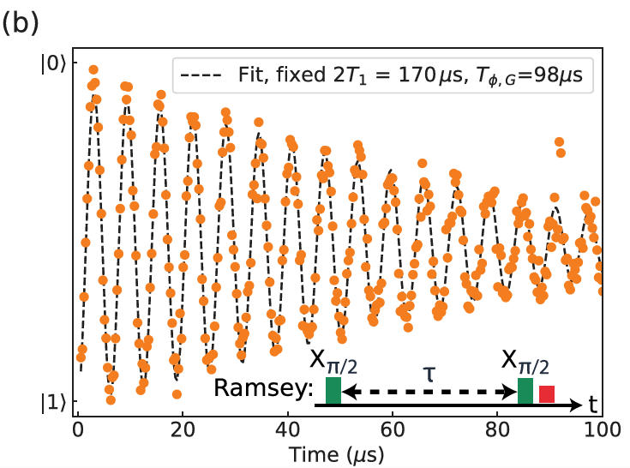
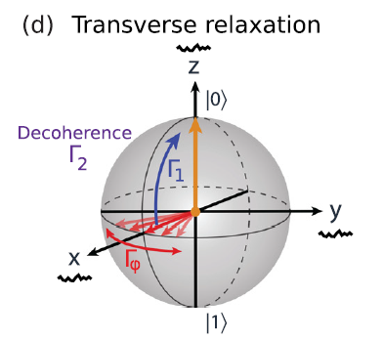
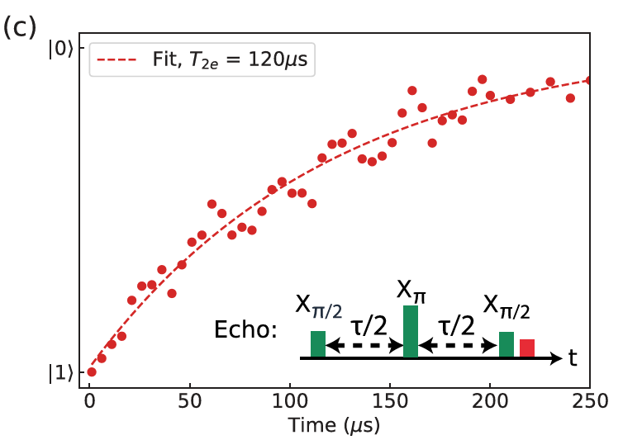
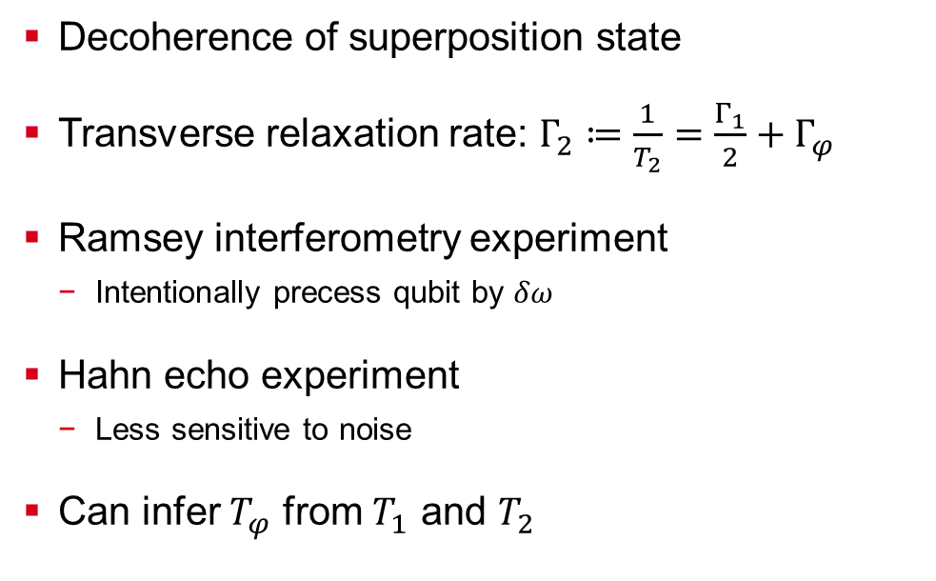
Transverse Relaxation
Decoherence of superposition state
Transverse relaxation rate: $Γ_{2}≔\frac{1}{T_{2}}=\frac{Γ_{1}}{2}+Γ_{φ}$
Ramsey interferometry experiment
Intentionally precess qubit by $δω$
Hahn echo experiment
Less sensitive to noise
Can infer $T_{φ}$ from $T_{1}$ and $T_{2}$

Slide 22
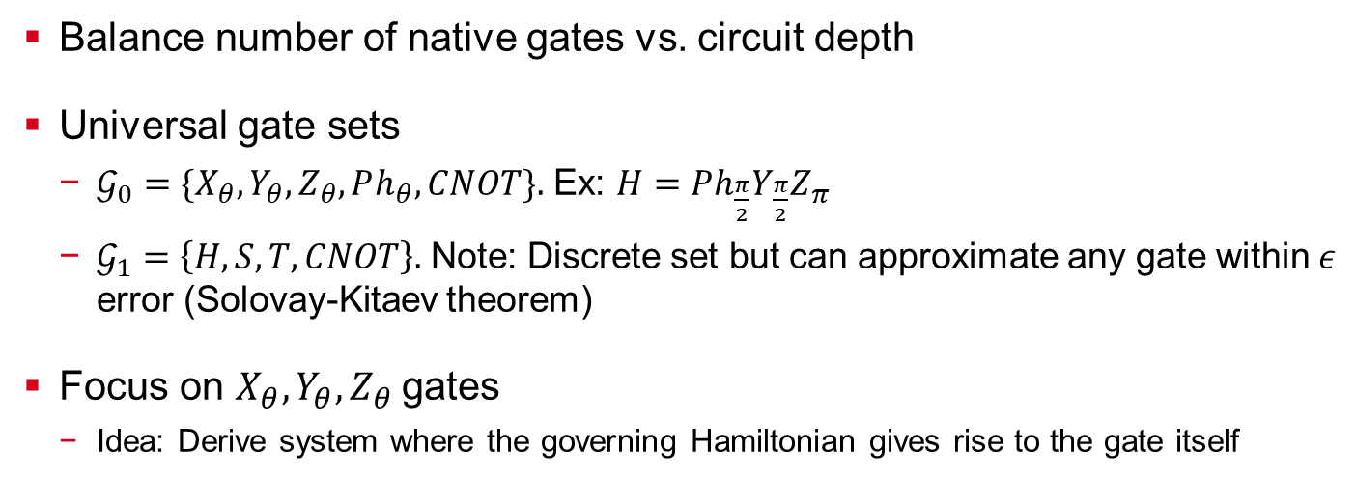
Quantum Logic Gates and Gate Synthesis
Balance number of native gates vs. circuit depth
Universal gate sets
$𝒢_{0}=\{X_{θ},Y_{θ},Z_{θ},Ph_{θ},CNOT\}$ Ex: $H=Ph_{\frac{π}{2}}Y_{\frac{π}{2}}Z_{π}$
$𝒢_{1}=\left\{H,S,T,CNOT\right\}.$ Note: Discrete set but can approximate any gate within $ε$ error (Solovay-Kitaev theorem)
Focus on $X_{θ},Y_{θ},Z_{θ}$ gates
Idea: Derive system where the governing Hamiltonian gives rise to the gate itself

Slide 23
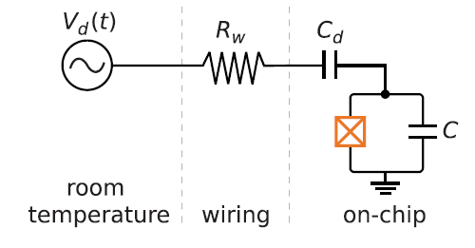
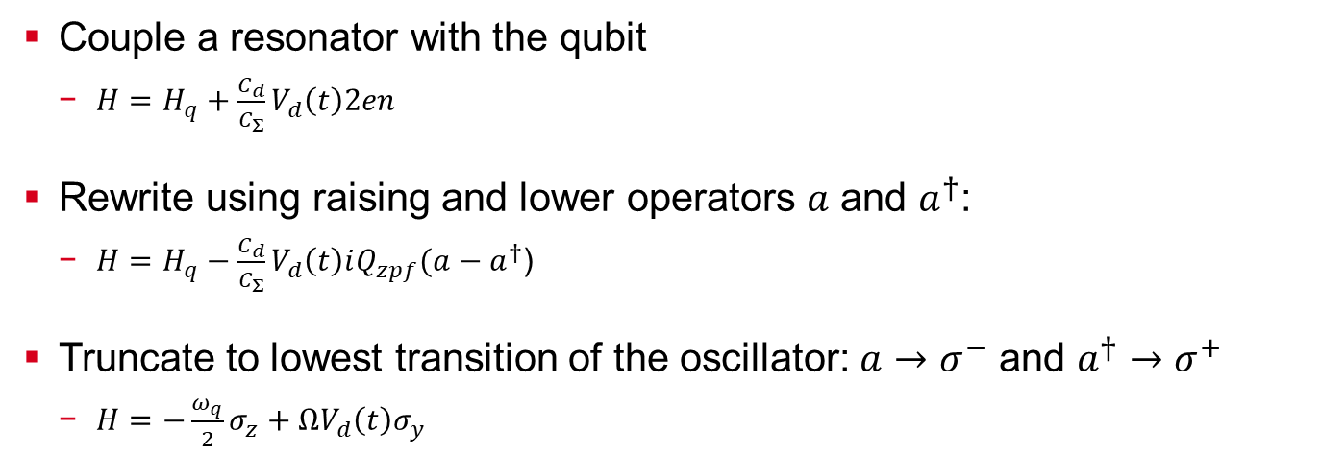
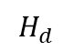

Capacitive Coupling for X,Y Gates – System Setup
Couple a resonator with the qubit
$H=H_{q}+\frac{C_{d}}{C_{Σ}}V_{d}\left(t\right)2en$
Rewrite using raising and lower operators $a$ and $a^{†}$:
$H=H_{q}−\frac{C_{d}}{C_{Σ}}V_{d}\left(t\right)iQ_{zpf}(a−a^{†}$)
Truncate to lowest transition of the oscillator: $a→σ^{−}$ and $a^{†}→σ^{+}$
$H=−\frac{ω_{q}}{2}σ_{z}+ΩV_{d}\left(t\right)σ_{y}$
$$H_{q}$$
$$H_{d}$$

Slide 24


Capacitive Coupling for X,Y Gates – Changing the Reference Frame
Want the Hamiltonian in a moving reference frame. Why?
If $\left|ψ_{0}\right\rangle =\frac{1}{\sqrt{2}}{\left(1,1\right)}^{T}$, then $\left|ψ_{0}(t)\right\rangle =U_{H_{q}}\left|ψ_{0}\right\rangle =\frac{1}{\sqrt{2}}{\left(e^{iω_{q}t/2},e^{−iω_{q}t/2}\right)}^{T}$
Phase is winding with frequency $ω_{q}$
Define $U_{rf}=e^{iH_{q}t}=U_{H_{q}}^{†},$and $\left|ψ_{rf}\left(t\right)\right\rangle =U_{rf}|ψ_{0}⟩$. Hamiltonian $H$ in the new reference frame:
$i∂_{t}\left|ψ_{rf}\left(t\right)\right\rangle =i\left(∂_{t}U_{rf}\right)|ψ_{0}⟩+iU_{rf}\left(∂_{t} | ψ_{0}\right\rangle )=(i{\dot{U}}_{rf}U_{rf}^{†}+U_{rf}HU_{rf}^{†})\left|ψ_{rf}\left(t\right)\right\rangle$
Plug in $H_{q},H_{d}$: see ${\tilde{H}}_{q}=0$ and ${\tilde{H}}_{d}=ΩV_{d}\left(t\right)\left(\cos{(ω_{q}}t\right)σ_{y}−\sin\left(ω_{q}t\right)σ_{x})$
$$\tilde{H}$$

Slide 25

Capacitive Coupling for X,Y Gates – Rewriting the Hamiltonian
Assume $V_{d}\left(t\right)=V_{0}s\left(t\right)\sin{(ω_{d}t+φ)}.$If $I=\cos{φ}$ and $Q=\sin{φ}$, then
${\tilde{H}}_{d}=ΩV_{0}s\left(t\right)\left(I\sin\left(ω_{d}t\right)−Q\cos{(ω_{d}t}\right))×(\cos{(ω_{q}}t)σ_{y}−\sin\left(ω_{q}t\right)σ_{x})$
Use rotating wave approximation (RWA) and using $δω=ω_{d}−ω_{q}$
${\tilde{H}}_{d}=\frac{1}{2}ΩV_{0}s\left(t\right)\left[\left(−I\cos\left(δwt\right)+Q\sin\left(δωt\right)\right)σ_{x}+\left(I\sin\left(δwt\right)−Q\cos\left(δwt\right)\right)σ_{y}\right]$
The driving Hamiltonian in the rotating reference frame:
${\tilde{H}}_{d}=−\frac{1}{2}ΩV_{0}s\left(t\right)\left(\begin{matrix}0 & e^{i(δωt+φ)} \\ e^{−i(δωt+φ)} & 0\end{matrix}\right)$

Slide 26

Capacitive Coupling for X,Y Gates – Evolving the Hamiltonian
Suppose we apply a pulse with $ω_{d}=ω_{q}$ then ${\tilde{H}}_{d}=−\frac{1}{2}ΩV_{0}s\left(t\right)\left[Iσ_{x}+Qσ_{y}\right]$
$φ$ pulse determines rotation axis
$(φ=0)$ $→$ rotations in the $x$-axis ($X_{θ}$-gate)
$(φ=π/2)$ $→$ rotations in the $y$-axis ($Y_{θ}$-gate)
How much does it rotate by? ${X_{θ}=U}_{rf,d}^{φ=0}\left(t\right)=\exp\left(\left[\frac{i}{2}ΩV_{0}\int_{0}^{t}{s\left(t^{′}\right)dt′}) \right]σ_{x}\right)$
The angle rotated is $θ\left(t\right)=−ΩV_{0}\int_{0}^{t}{s\left(t^{′}\right)dt^{′}}$
Ideally, solve $θ\left(t\right)=π$ to determine $t$
Reality, apply a sequence of pulses to generate angles $θ_{k},θ_{k−1},…,θ_{0}$

Slide 27


Capacitive Coupling for X,Y Gates – Schematic
(a) Schematic of the qubit drive
Arbitrary waveform generator (AWG) supplies pulse-envelope $s(t)$ with low frequency $ω_{AWG}$
LO source signal supplies high frequency $ω_{LO}$
IQ mixer produces $V_{d}\left(t\right)$
(b) Gate sequence is converted into waveform generated by $AWG$
(c) Action of $X_{π/2}$ gate

Slide 28





Virtual Z-Gate
Can implement a $Z_{θ}$ gate without having to implement a gate, or perform any additional operations
Let $X_{θ}^{(φ_{0})}$ be a $θ$ pulse with phase $φ_{0}$, then $X_{θ}^{(φ_{0})}=Z_{−φ_{0}}X_{θ}Z_{φ}$
Let $U_{i}$ be arbitrary, then
z
$$φ_{0}$$
x
y
$$θ$$
becomes
Should be minus sign in superscripts,
verify in presentation

Slide 29

Universal Single Qubit Gate Set
Any single-qubit gate is of the form $U\left(θ,φ,λ\right)=Z_{φ−\frac{π}{2}}X_{\frac{π}{2}}Z_{π−θ}X_{\frac{π}{2}}Z_{λ−\frac{π}{2}}$
With a virtual-$Z_{θ}$ gate and physical $X_{\frac{π}{2}}$ $→$ complete single-qubit gate set!
Ex: $H=Z_{\frac{π}{2}}X_{\frac{π}{2}}Z_{\frac{π}{2}}$
Can implement Hadamards as an (effectively) single-pulse operation

